Slide 1
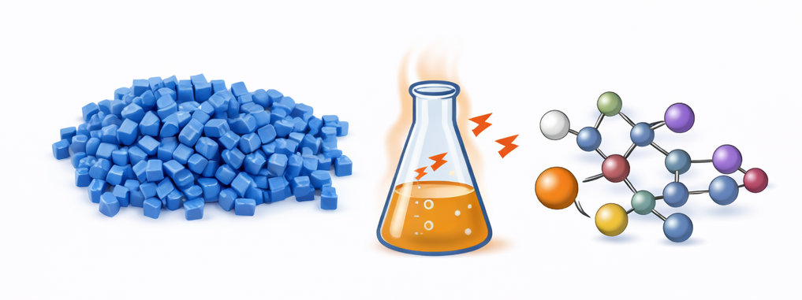

Modeling Heat Stabilizer Performance​ for Polymer Formulations
By: Kalyani Jaywant Khandait, Daniyar Abykhanov, Dylan Trott
Notes:
AI-generated image using DALL·E (OpenAI), 2026.

Slide 2
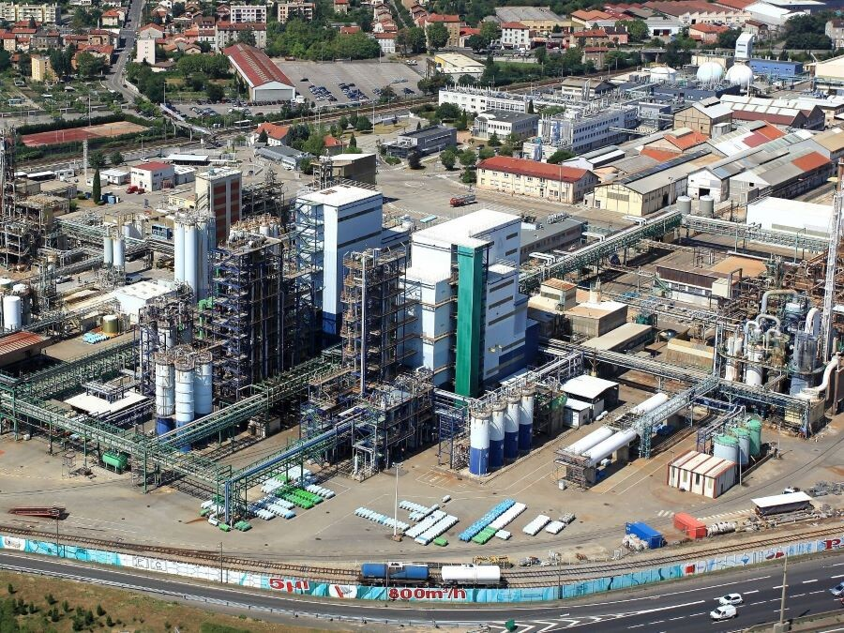
About Arkema
Large-scale industrial chemical manufacturer
Our project is working with their thiochemicals department, which specializes in sulfur-based compounds such as
Adhesive materials
Polymer additives like chain transfer agents
R&D Department places a heavy emphasis on green chemistry for tackling issues like carbon capture storage additives and additives for improving mineral processing
Arkema. (2025). [Photograph of Arkema headquarters lightwell, La Défense, France]. Arkema France. https://www.arkema.com/france/en/locations/

Slide 3
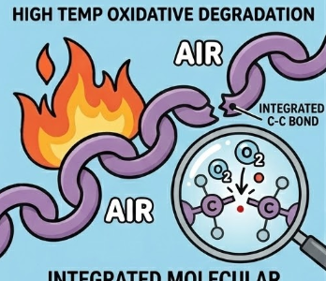
Problem Statement
Issue:
Polymers react spontaneously with oxygen at higher temperatures, creating destructive peroxyl radicals
Two Ways to Prevent Oxygen Degradation:
Run reactions in air free environment (Costly & difficult to scale-up)
Use a radical scavenger to ‘quench’ the radicals before they degrade the product
Image generated using Google Gemini

Slide 4
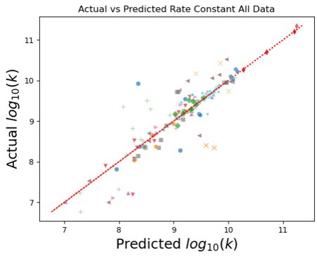
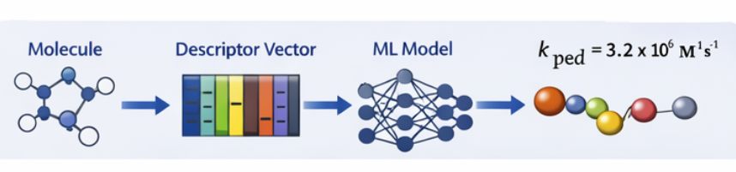
Project Objective
To develop a machine learning model that quantifies and ranks antioxidant reactivity to enable rational heat stabilizer design
Machine learning predicted antioxidant reaction rates with the hydroxyl radical (OH)
Source: UDel NRT Spring 2025 course
https://sites.udel.edu/midas-nrt/
Notes:
Final Output to Arkema
✔ Predictive model(s) for radical scavenging rates ✔ Quantitative ranking tool ✔ Data coverage assessment ✔ Framework for accelerated stabilizer discovery

Slide 5
Proposed Approach
Evaluation
Build structured kinetic database
Exploration Phase
Machine Learning
Standardize data (units, temperature, solvent, pH)
Generate molecular & environmental descriptors
SMILES
Morgan Fingerprint
Cluster antioxidants by structure & descriptor space
Identify molecular subgroups
Compare global vs cluster-specific models
Exploratory data analysis
Feature engineering
Compare linear and non-linear models
Pick features and hyperparameters using cross-validation
Model evaluation R², MSE, MAE, RMSE
Final Deliverables

Slide 6
Anticipated Issues
Data Challenges
Imbalance & potential data loss
Missing data in specific radical groups
High variability in conditions
Modeling Risks
Overfitting in subgroup models
Hidden dependence on solvent / pH
Feature & Clustering Risks
Descriptor redundancy / noise
Poor cluster separation (not visible in 2D)
Sparse regions in descriptor space
Notes:
Imbalance in data as well as data loss during transformation
Data may depend strongly upon factors which are outside of our model
(solvent, pH) - > Simplify our model to more specific use cases
High variability across reaction conditions and missing data in specificgroups -> Use standered practices for missing data
Overfitting in subgroup models ( thus Using cross-validation &regularization)
Insufficient cluster separation, may not be visible in 2D and also get sparse data patterns -> ( for insufficient cluster separation use and compare different clustering methods, -> Validate clustering using quantitative metrics eg Silhouette score -> for sparse data need scaling and filtering) Descriptor redundancy / noise ( dimention reduction)

Slide 7
Approach Justification
Addressing Anticipated Issues with Backup Strategies
SMILES provides a standardized, scalable molecular representation
Morgan fingerprints capture structural patterns driving radical reactivity
Descriptor-based clustering enables chemically meaningful subgroup modeling
Subgroup models may outperform a single global model, helping determine whether a general model or subgroup-specific models provide more accurate and reliable predictions
Cross-validation ensures robustness and generalizability

Slide 8
Rough Timeline
Week 1 | Week 2 | Week 3 | Week 4 | Week 5 | Week 6 | Week 7
Literature Data Collection
Structured dataset creation
Preprocessing
Data Cleaning & Standardization
Exploration Phase
Feature Engineering
Model Development
Model Evaluation & Ranking

Slide 9
Current Stage and Challenges facing
Week 1 | Week 2
Collecting kinetic data from multiple literature sources​
Limited studies under consistent environmental conditions
Literature Data Collection
Structured dataset creation
Preprocessing
Data Cleaning & Standardization
• Variability in: - Temperature (e.g., 333K vs 400K) - Units & notation formats - Reaction mechanisms & solvent systems
• Working on: - Standardizing units and naming conventions - Normalize temperature-dependent values where feasible - Minimize data loss during cleaning

Slide 10
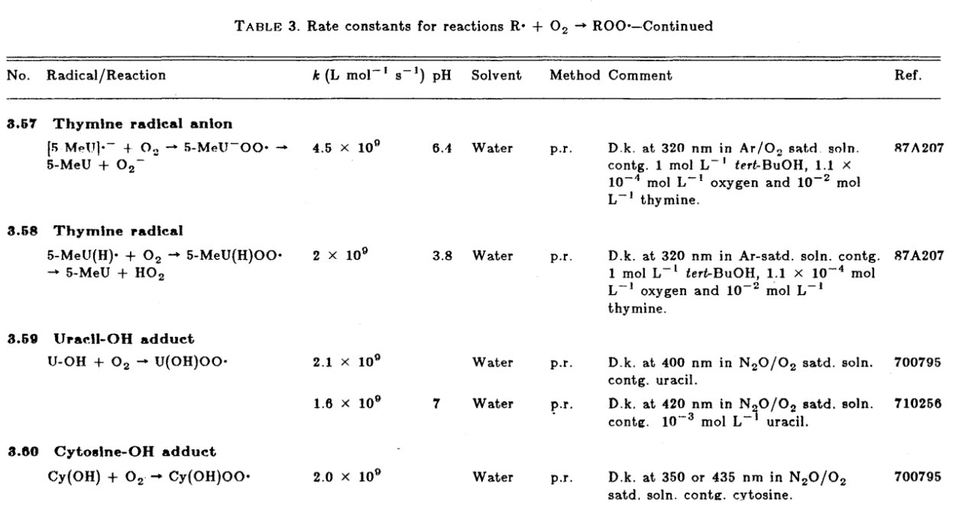
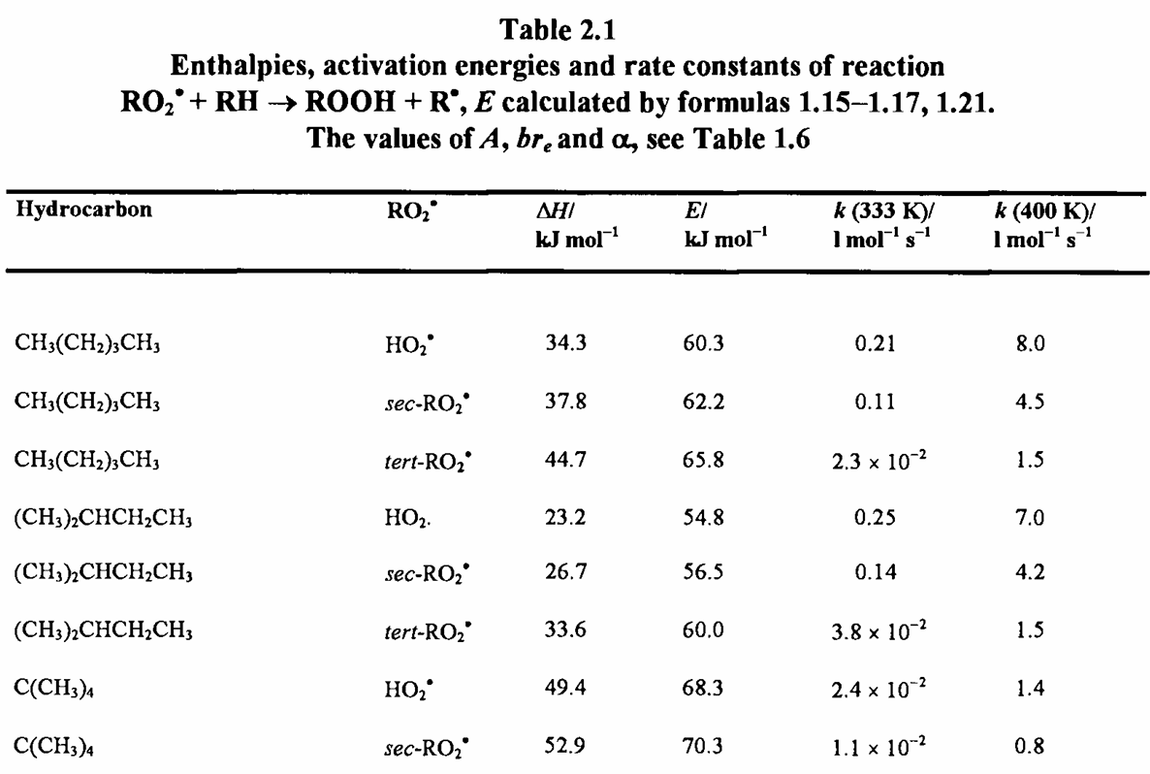
https://doi.org/10.1201/9781351072373
https://doi.org/10.1063/1.555854

Slide 11
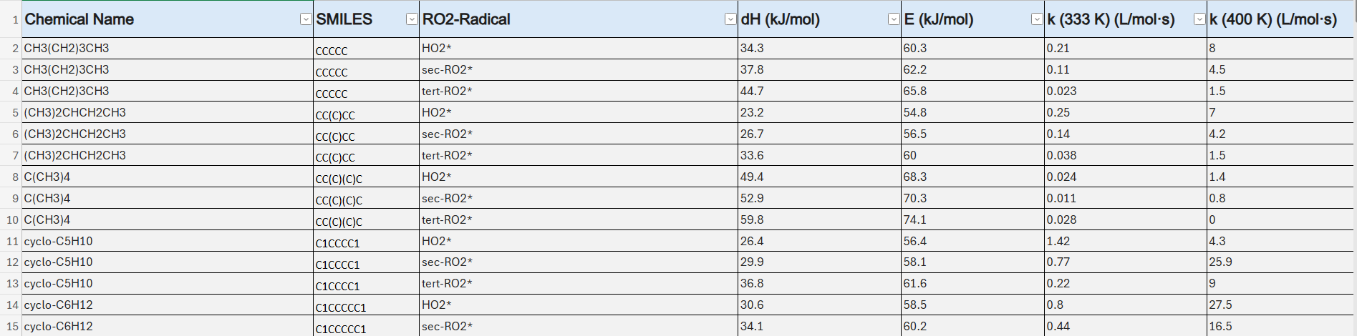
We Did It- Primary Dataset Ready !
~90% of primary dataset consolidated (major source completed)​
640 entries with phenol, hydroxylamine, amine, and phenoxyl subgroups
SMILES extracted for molecular encoding​
Currently evaluating best molecular representations (Morgan fingerprints, descriptors)​

Slide 12
Expected Results
Technical Outcomes
Expanded radical reactivity models beyond hydroxyl radicals
Improved prediction accuracy for polymer-relevant radicals
Identification of key structure–reactivity relationships
Quantified benefit of subgroup-specific modeling
Analytical understanding of structure-property relationships in antioxidant radical scavenging
Business & Strategic
• Accelerated stabilizer development cycle • Reduced experimental screening & resource use • Support for sustainable material innovation • Data-driven decision support for polymer applications • Scalable digital framework for future sulfur-based specialties
Notes:
For slide content - Used AI (ChatGpt to reduce text)

Slide 13

Questions?

